Slide 2

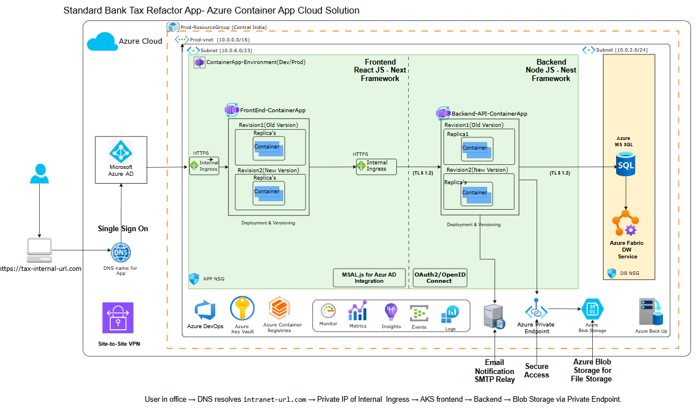
Cloude Architecture View-VM in Azure, Fabric DW, SharePoint

Slide 3
Cloude Architecture View-VM in Azure, Fabric DW, SharePoint

Slide 4
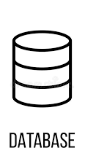












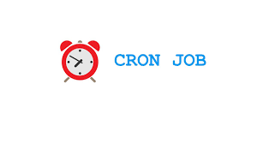


Proposed Architecture
1
Presentation Layer
2
API Gateway
3
Backend Microservices
5
Backend Down Stream Systems
Design System
REST / GRAPHQL / GRPC - API
Application Building blocks
AI Model Microservice
User Access /Role Management
External API
Routing
Library
API
Gateway
Search Functionality API
User Views
End User
Information(Profile)
Notification Services
Component
HTTPS Call to API
HTTPS
Insurance Verification Microservice
Wrappers/ Helper/ Utilities
User Access and Role Management
Authentication / Authorization
Services
CONNECTOR
4
Amazon Bedrock (Generative AI/GPT)
Utilities
Modules
Bulk Upload
WEB
Parser for Feed File Generation
Login Functionality
Modules(n)
Identity
Provider
Web App
Search Functionality
Reporting and Data Export
Text
Generation
Chatbots
Image
Generation
Archive
Purge
Information (profile) Display
User Specific Views
Search
Text
Summarization
Personalization
GPT- Chatbot
SUPPORTING
PLATFORM
Microfrontend Composed Application(s)
Gateway
AA IT OPS
MONITORING & NOTIFICATION
SECURITY & ACCESS CONTROL
Above proposed Architecture diagram will be refined post Solution Engineering Phase
Middleware Service Layer

Slide 5
VendorPulse — Solution Architecture (Shell)
Single-tenant in Shell Azure · deterministic-first, AI-second · agent layer MAF SDK → Microsoft Foundry
Shell Azure Subscription
External (outbound HTTPS)
Client (browser · Shell SSO)
Azure App Service (container) — FastAPI app
Microsoft Entra ID
Shell SSO · groups→roles · app identity
Entra OIDC auth + RBAC
12-state WorkflowEngine
VMO Coordinator · Sponsor · Viewer
authenticated via Entra SSO
Azure Front Door + WAF
TLS · OWASP · origin-lock
Approval gate
MAF Agent layer → Foundry
Microsoft Foundry
Responses API + content safety
React 19 SPA — Design System
ApprovalPanel · WorkflowProgressBar
Deterministic services
GraphService
Data Tier — Managed Identity · Private Link (no public access)
Microsoft Graph (Shell tenant)
Mail.Send · Calendars ·
Azure PostgreSQL
Flexible Server
Azure Key Vault
Blob Storage
App Insights + Log Analytics
Database = Azure PostgreSQL (Flexible Server) in the Data Tier, reached via Private Link + Managed Identity. Deterministic core is code; LLM only drafts behind the approval gate. Aligned to docs-archive/updated v2.0 (ADR-002/004/005) + issue #13.

Slide 6
VendorPulse — Deployment Architecture (Shell Azure)
Single-tenant · West Europe · Azure App Service · Private VNet · app-only certificate auth
👤 Shell user
on corporate network
☁ Shell Azure Subscription
External (outbound HTTPS)
Azure Front Door + WAF · TLS 1.2+ · OWASP · origin-locked to App Service
Microsoft Foundry
Responses API + content safety
🔒 Private VNet (VNet integration · Private Endpoints)
Microsoft Entra ID
Shell SSO
Azure App Service (Linux container)
Data Resource Group
Microsoft Graph (Shell)
Mail · Calendar · Teams (app-only cert)
Production slot (TLS 1.2+)
Postgres
Flexible
Key Vault
cert · keys (PE)
Single Sign-On
OIDC / MSAL
SPA (React/nginx)
Private Link
FastAPI + MAF agents
Blob Storage
minutes (PE)
Entra ID (app reg)
VendorPulse-Prod · cert in KV
Vendorpulse.it.shell.com ( Example )
DNS → Front Door
Staging slot
blue-green / zero-downtime swap
Private Link
Shell egress proxy
outbound control
DevOps & Observability
Azure Devops
Container
Registry (ACR)
Azure Monitor
Application
Insights
Log Analytics
immutable audit
Shell user → DNS resolves vendorpulse.it.shell.com → Front Door (WAF) → App Service (private) → PostgreSQL via Private Link · Graph & Foundry via outbound HTTPS (egress proxy) · Managed Identity to KV/DB, app-only certificate to Graph

